Slide 1

Stress Detection
M908 – MINI PROJECT
Christina-Theano Kylafi
lt1200012

Slide 2

Introduction
Comparative Research
Classification algorithms and NNs
Logistic Regression, k Nearest Neighbors, Support Vector Machine, Random Forest
Kaggle Dataset: “Stress Analysis in Social Media”
Paper: “Dreaddit: A Reddit Dataset for Stress Analysis in Social Media”
Experiments
BiLSTM, CNN, BiGRU
Feature engineering
Parameter fine-tuning
Feature selection
Train set: 2820 samples | Test set: 715 samples
Lexical, syntactic & social media features
Goal
Feature type contribution to stress detection
Discover possible patterns useful to mental health tasks

Slide 3
Dataset Features
Lexical
DAL – Dictionary of Affect in Language ( Pleasantness, Activation, Imagery ) Emotional experience can be captured by a set of underlying dimensions. According to one dimensional framework, valence (also known as “hedonic tone” or pleasantness-unpleasantness) and activation (also known as arousal) are the two fundamental dimensions organizing emotional experience. Emotive imagery is also crucial, and used as a third dimension here.
Social Media
Upvote / Downvote ratio
Sentiment – Pattern Library (Python library for NLP tasks – sentiment analysis, n-grams, word corrections, lexical tasks, etc. )
Syntactic
F-K – Flesch-Kincaid Grade Level ( readability of a text )
ARI – Automated Readability Index ( understandability of a text )
Karma (net score of post)
Comment number
LIWC – Linguistic Inquiry and Word Count – 93 categories ( examples in next slide )
Reddit

Slide 4
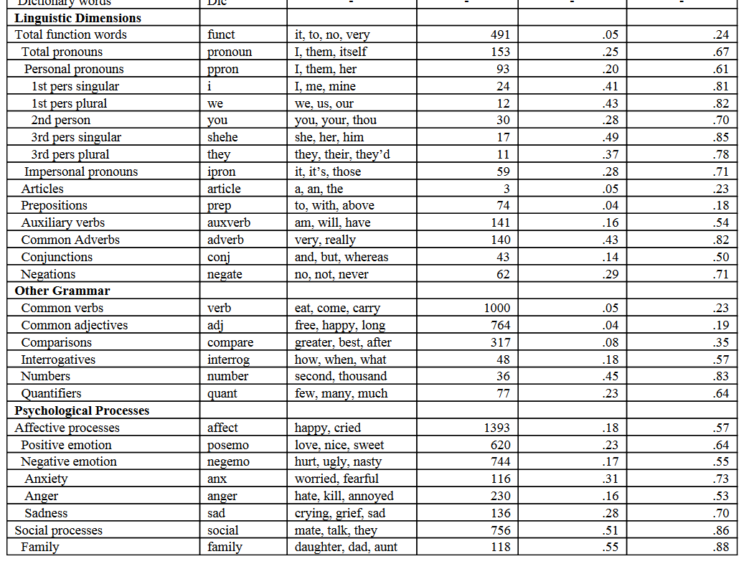
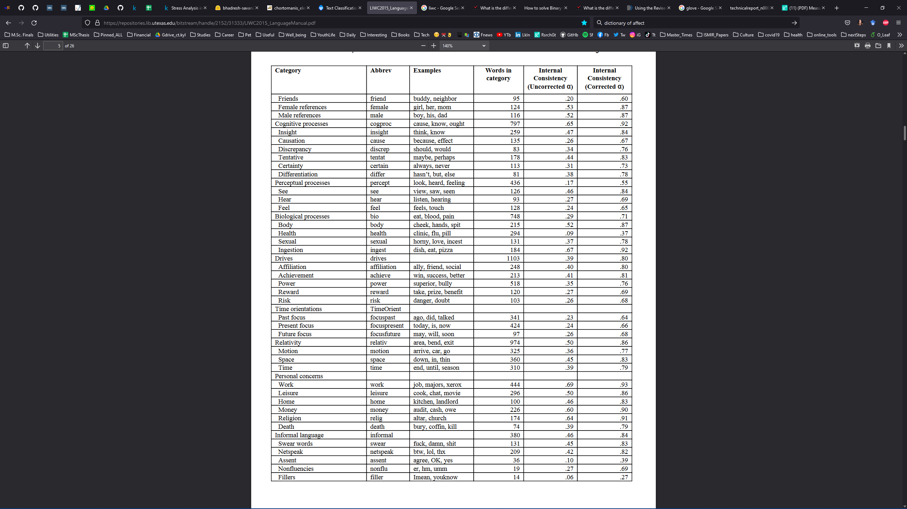
LIWC

Slide 5
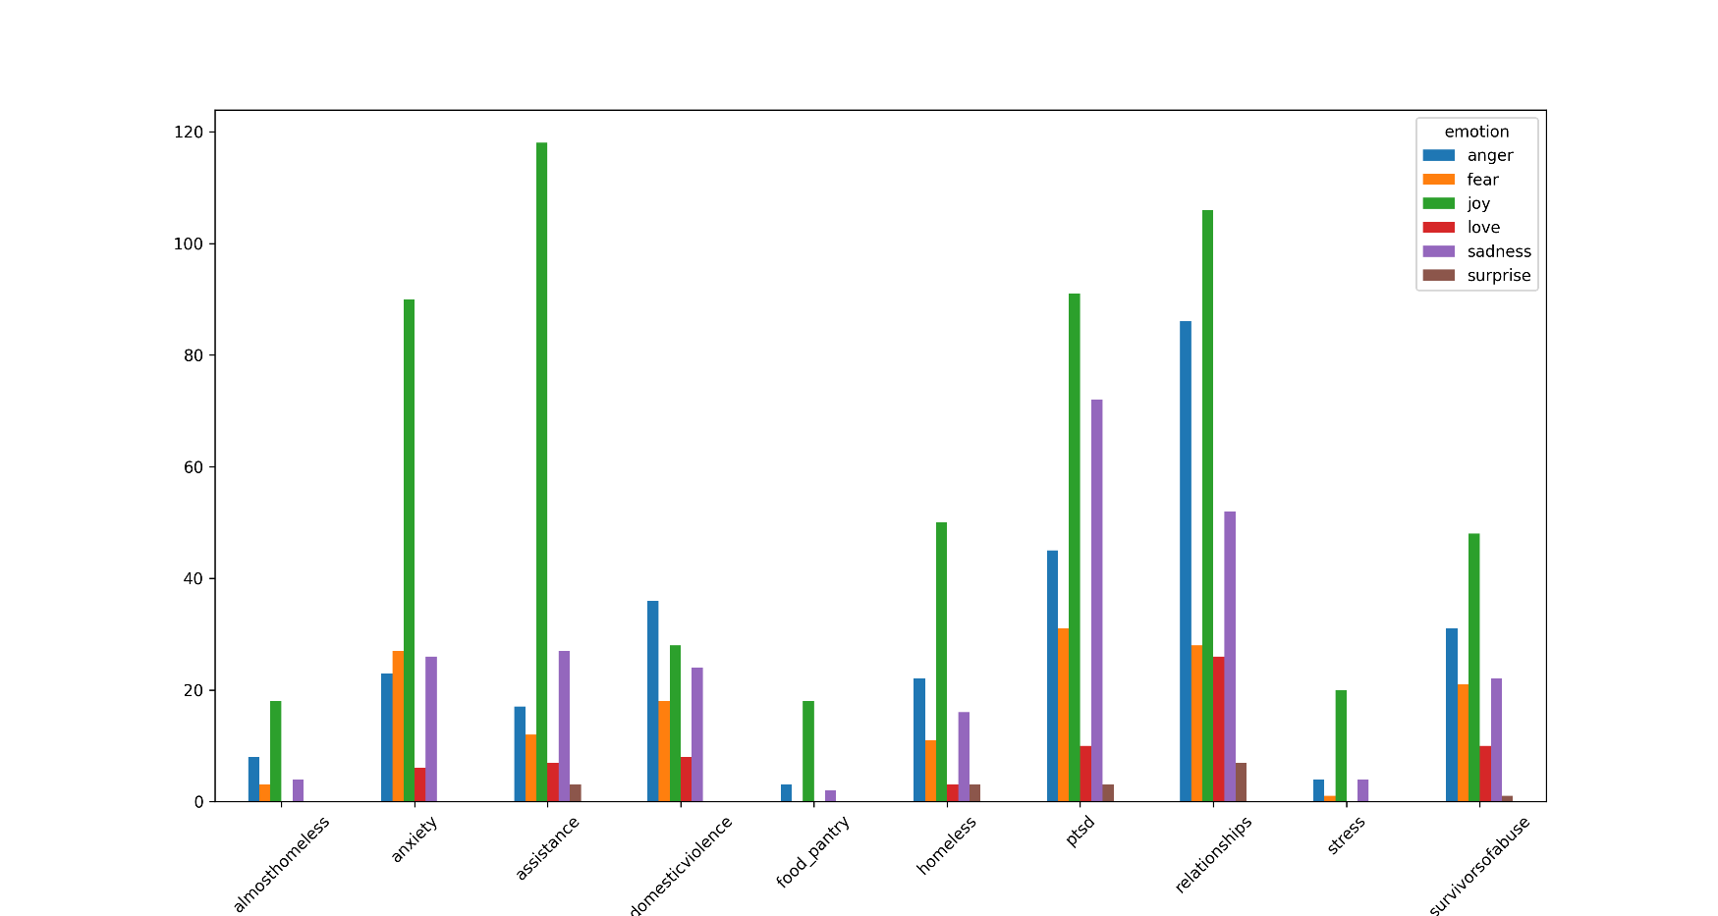
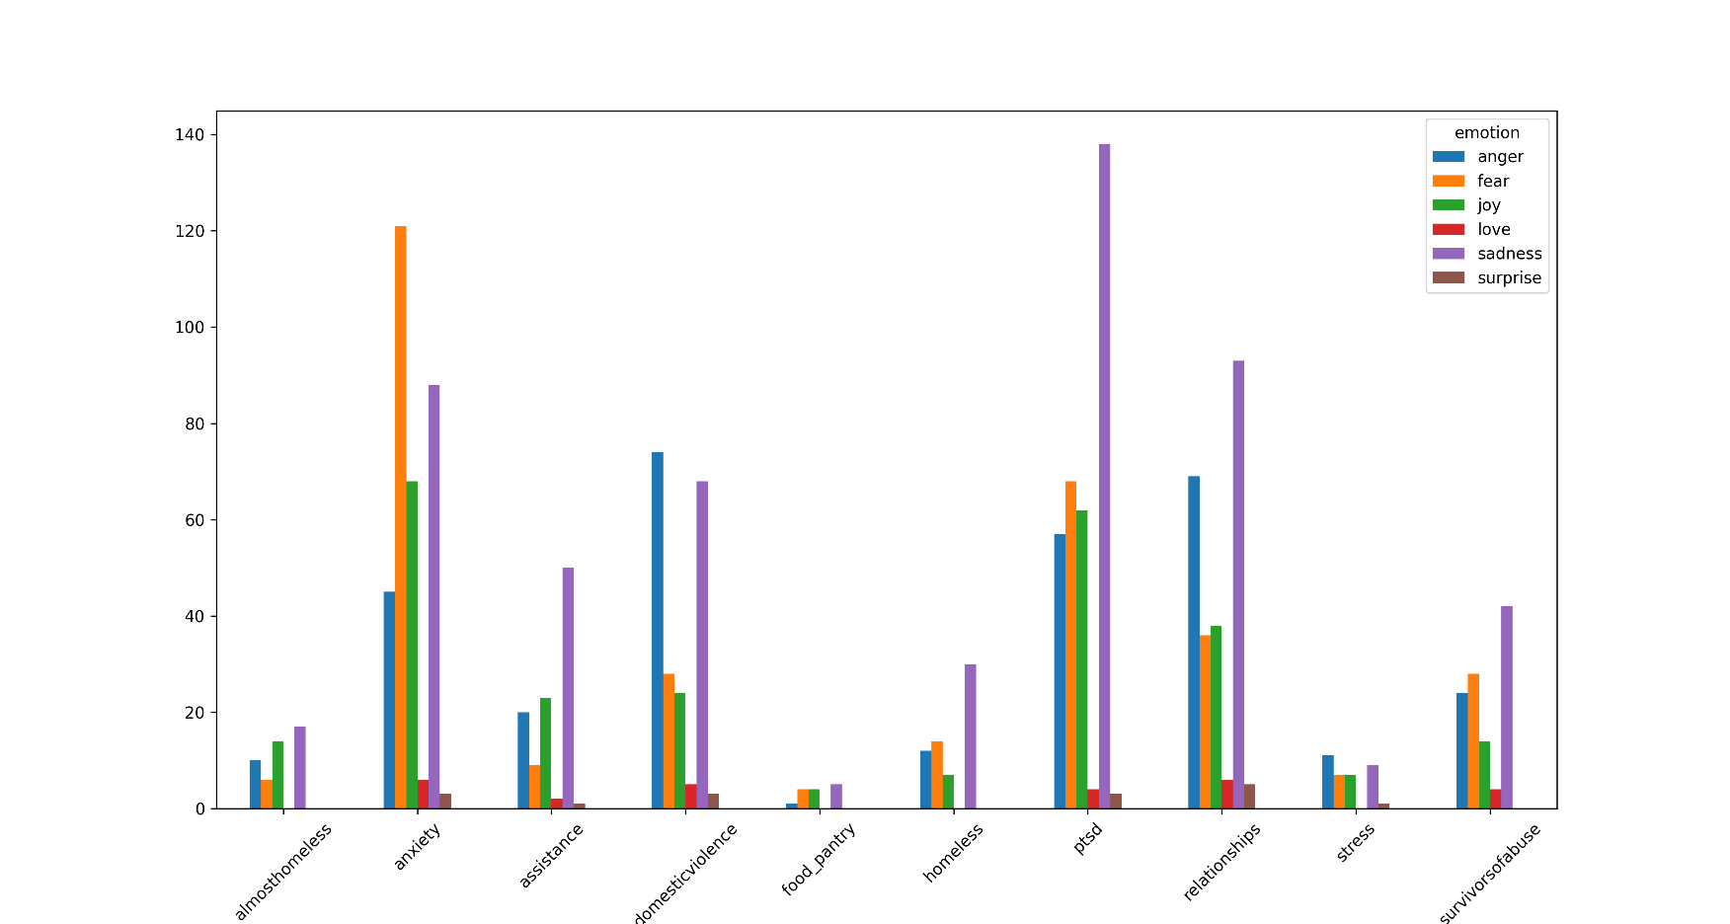
Dataset Visualization I
Figure 1. Label: Not stressed -> Subreddit – Emotion graph
Figure 2. Label: Stressed -> Subreddit – Emotion graph

Slide 6
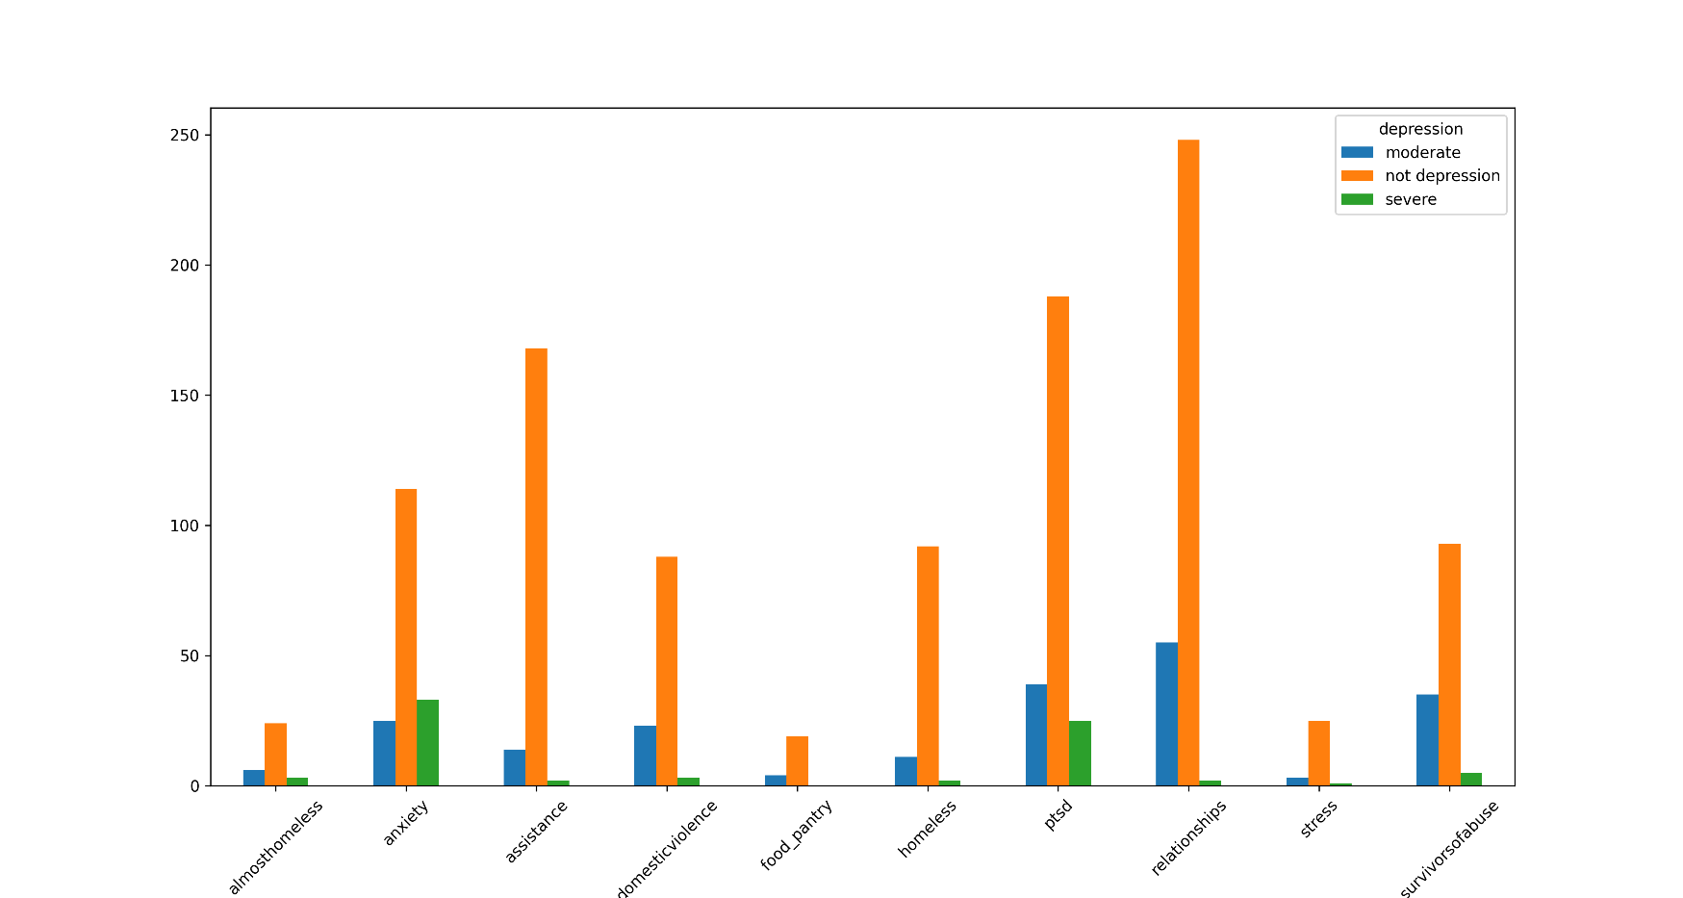
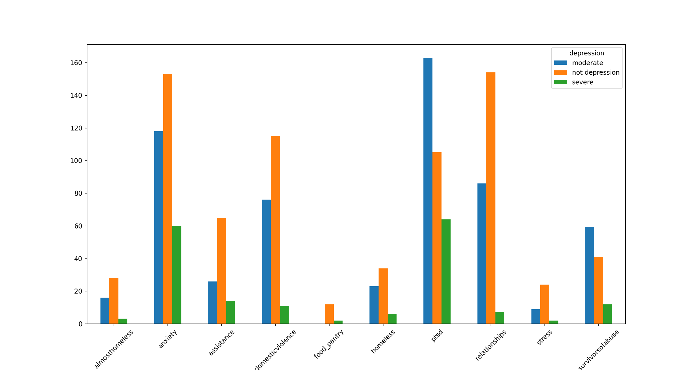
Dataset Visualization Ii
Figure 3. Label: Not stressed -> Subreddit – Depression graph
Figure 4. Label: Stressed -> Subreddit – Depression graph

Slide 7

Steps
Data Pre Processing
Evaluation
Training

Slide 8
Data Pre processing – feature extraction / engineering
BERT
Word2Vec
Google News pre-trained Word2Vec embeddings
Vector Dimension: 768
Hidden layer text embeddings
Vector Dimension: 300
Average of Word2Vec vectors
Emotion
Depression
bhadresh-savani/distilbert-base-uncased-emotion
paulagarciaserrano/roberta-depression-detection
6 labels - sadness, joy, fear, love, anger, surprise
Emotion score for each class
3 labels – not depression, moderate, severe
Depression score for each class

Slide 9
Data Pre processing – feature selection
All numerical features
All numerical features + text embeddings
Only LIWC lexical features
LIWC lexical features + text embeddings
Only DAL lexical features
DAL lexical features + text embeddings
Lexical & syntactic from the initial dataset + emotion + depression class & score
No text embeddings
Only text embeddings
Only lexical features
Lexical features + text embeddings
Only emotion features
Emotion features + text embeddings
Emotion class + score, depression class + score, sentiment, lexical features related to emotion (“lex_liwc_sad", "lex_liwc_anger", "lex_liwc_anx[iety]", "lex_liwc_negemo", "lex_liwc_posemo", "emotion", "emotion_score", "depression", “depression_score“, "sentiment“)
LIWC, DAL, sentiment from Pattern Library

Slide 10
Training - classifiers
Non NNs
Logistic Regression
k Nearest Neighbors
Support Vector Machine
Random Forest
NNs
Bidirectional LSTM
Layers:
Dense
Bidirectional LSTM
Dense
Dropout
Dense
CNN
Layers:
Convolutional
Max Pooling
Convolutional
Max Pooling
Flatten
Dense
Dropout
Dense
Bidirectional GRU
Layers:
Bidirectional GRU
Dropout
Dense
Dropout
Dense
Dropout
Dense

Slide 11
Training – parameter fine-tuning
Algorithms
Neural Networks
Grid Search
Regularization parameter
Data scaling
Grid Search
Data scaling
Neighbor number
Solver
Max iterations
Layer units
Layer activation functions
Dropout rate
Kernel regularizers
Filters
Filter size

Slide 12
Evaluation – scores
Class Scores (All Features) |  |  | Text Embeddings | Classifier
Class 0 (not stressed) | Recall | 0.78 | Word2Vec | KNN
 | Precision | 0.84 | Word2Vec | KNN
 | F₁ | 0.81 | Word2Vec | KNN
Class 1 (stressed) | Recall | 0.87 | Word2Vec | KNN
 | Precision | 0.81 | Word2Vec | KNN
 | F₁ | 0.84 | Word2Vec | KNN

Slide 13
Evaluation – Learning Curves ( Loss )
Word2Vec – CNN All Features
Word2Vec – BiGRU LIWC
Word2Vec – BiGRU Emotion & Depression
BERT – BiGRU Emotion & Depression
BERT – CNN All Features
BERT – BiGRU LIWC
Word2Vec – BiGRU Lexical Features
BiGRU Only Emotion & Depression
BERT – BiGRU Lexical Features

Slide 14
Evaluation – Learning Curves ( F₁ )
Word2Vec – CNN All Features
Word2Vec – BiGRU LIWC
Word2Vec – BiGRU Emotion & Depression
BERT – BiGRU Emotion & Depression
BERT – CNN All Features
BERT – BiGRU LIWC
Word2Vec – BiGRU Lexical Features
BiGRU Only Emotion & Depression
BERT – BiGRU Lexical Features

Slide 15
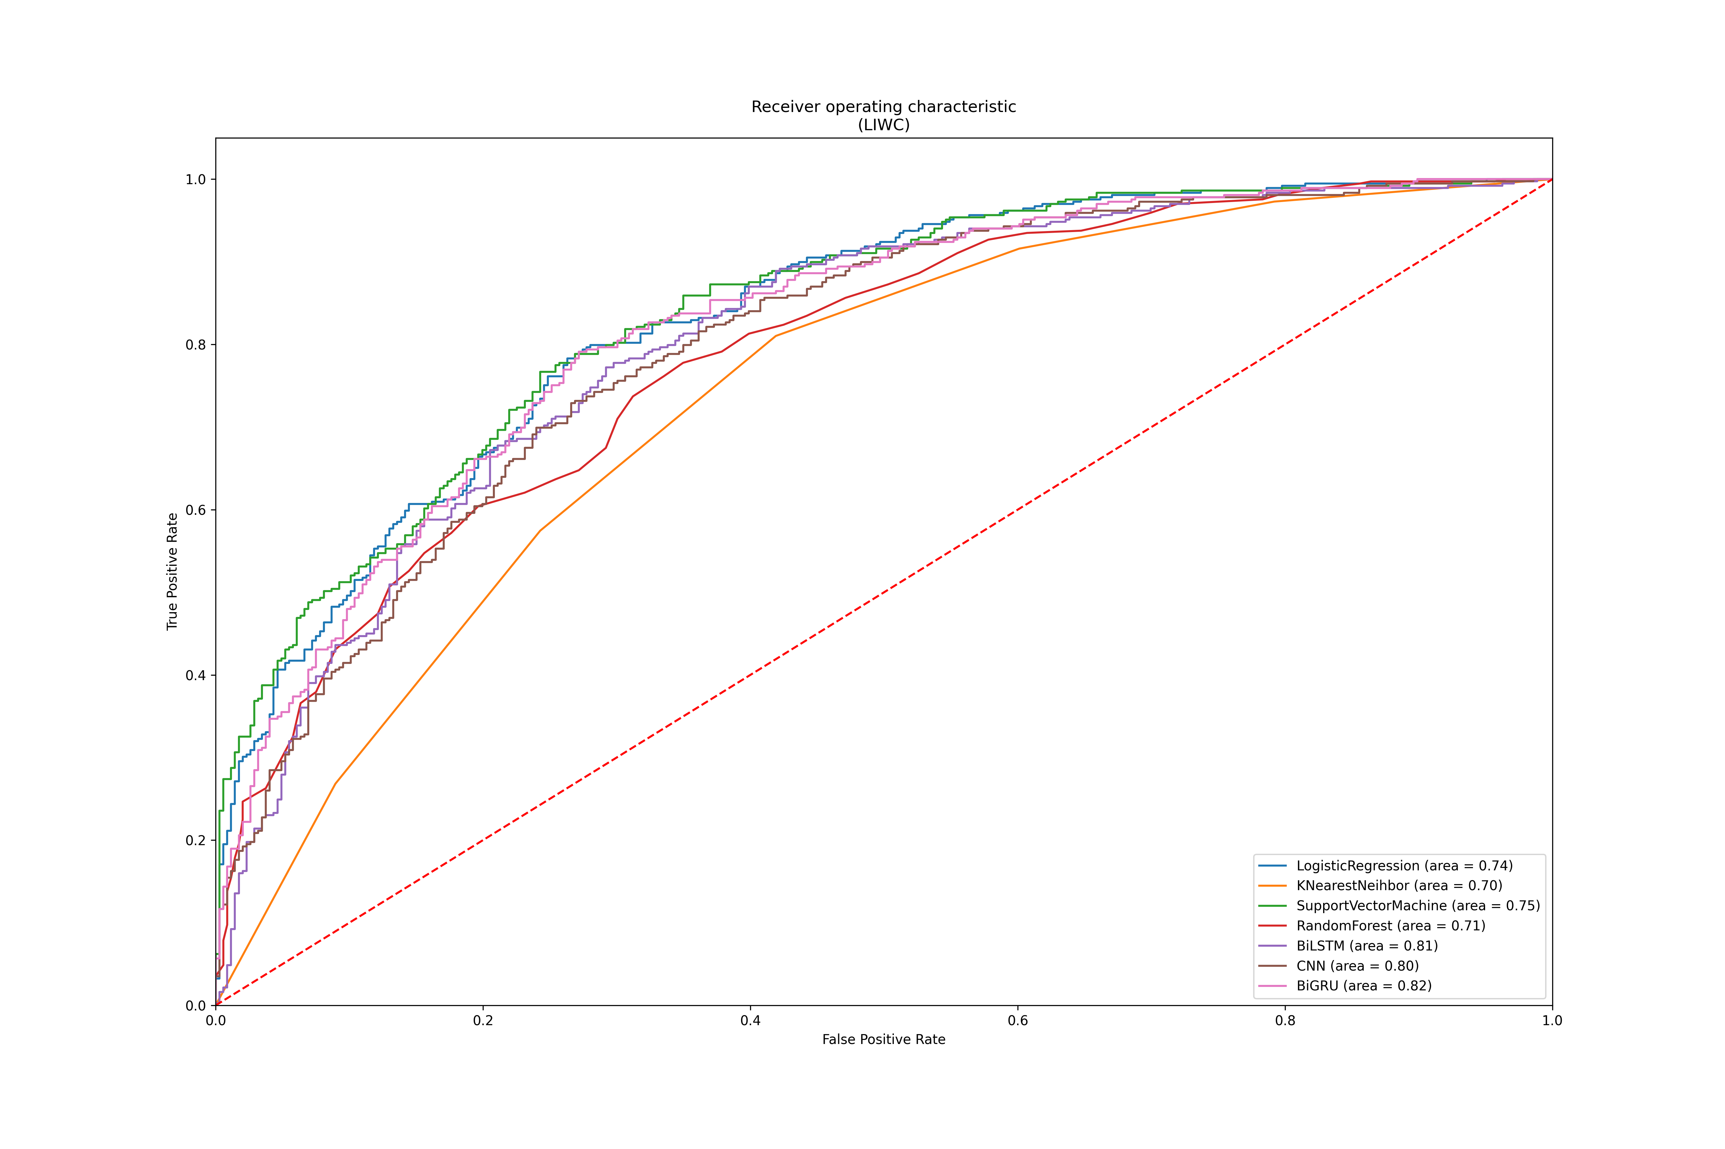
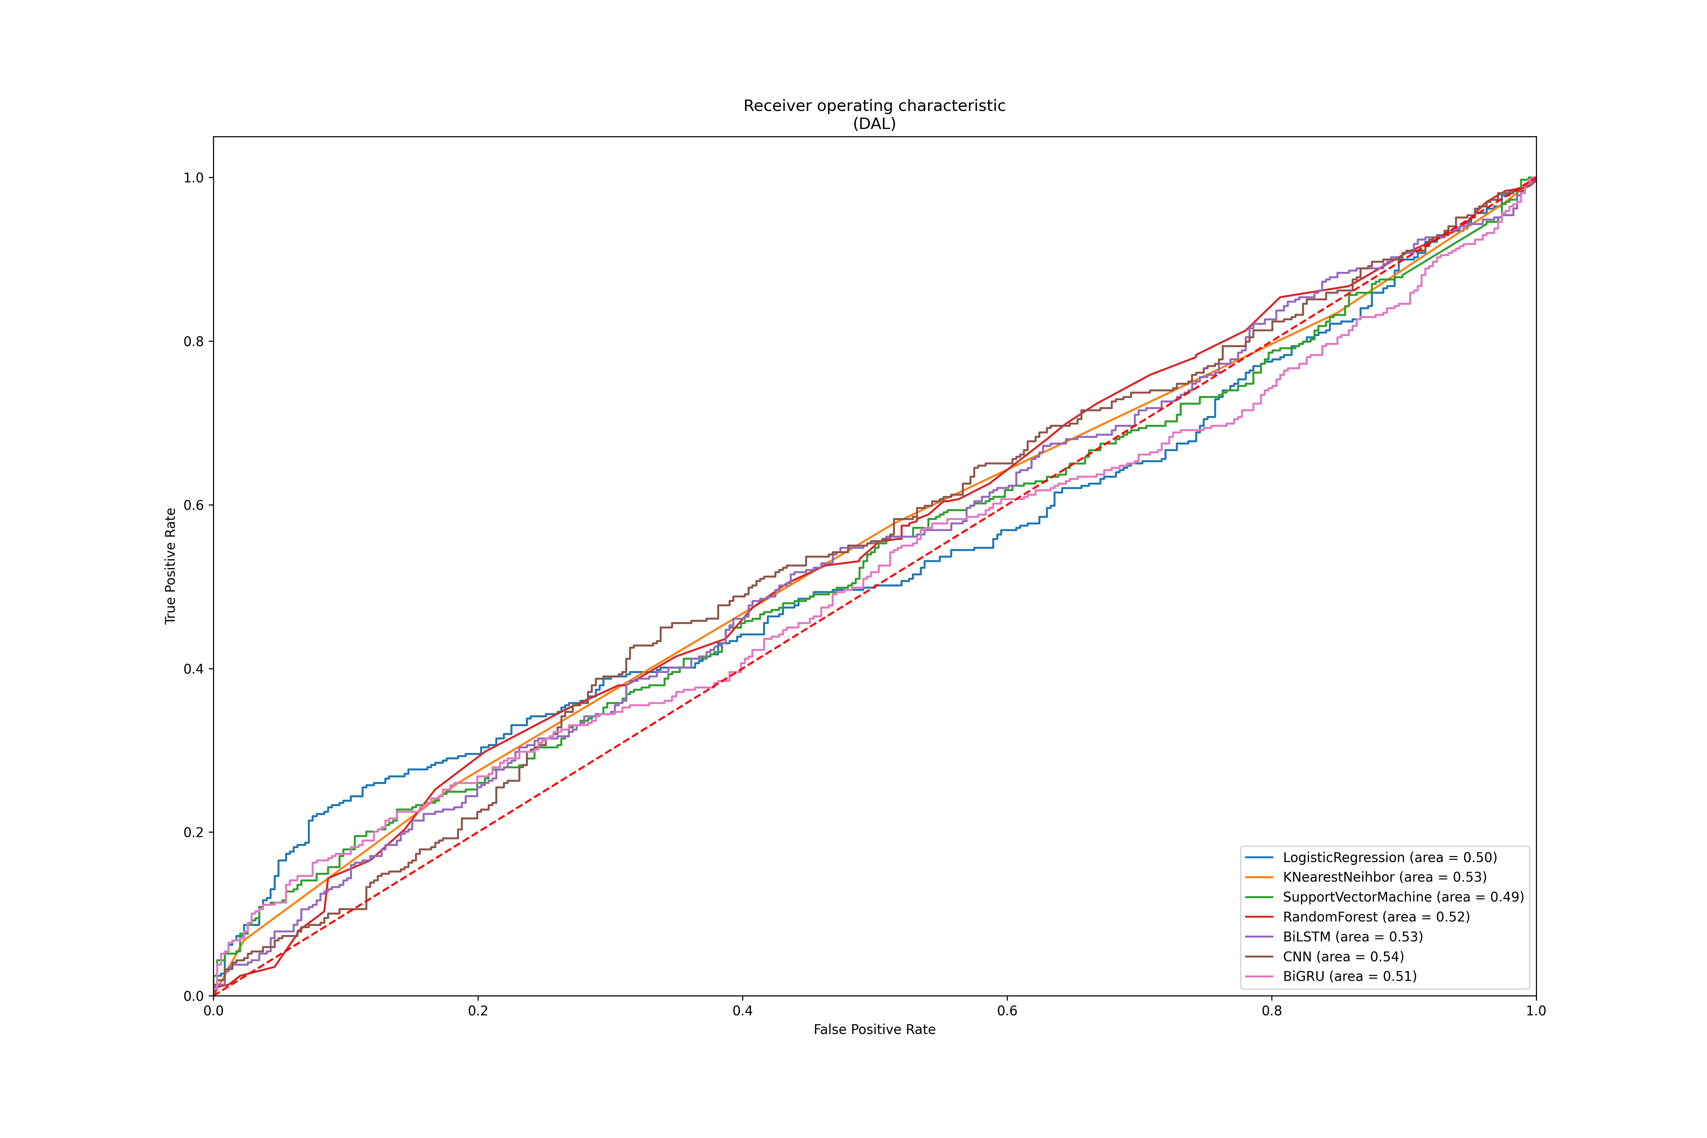
Evaluation – ROC Curves I
BERT

Slide 16
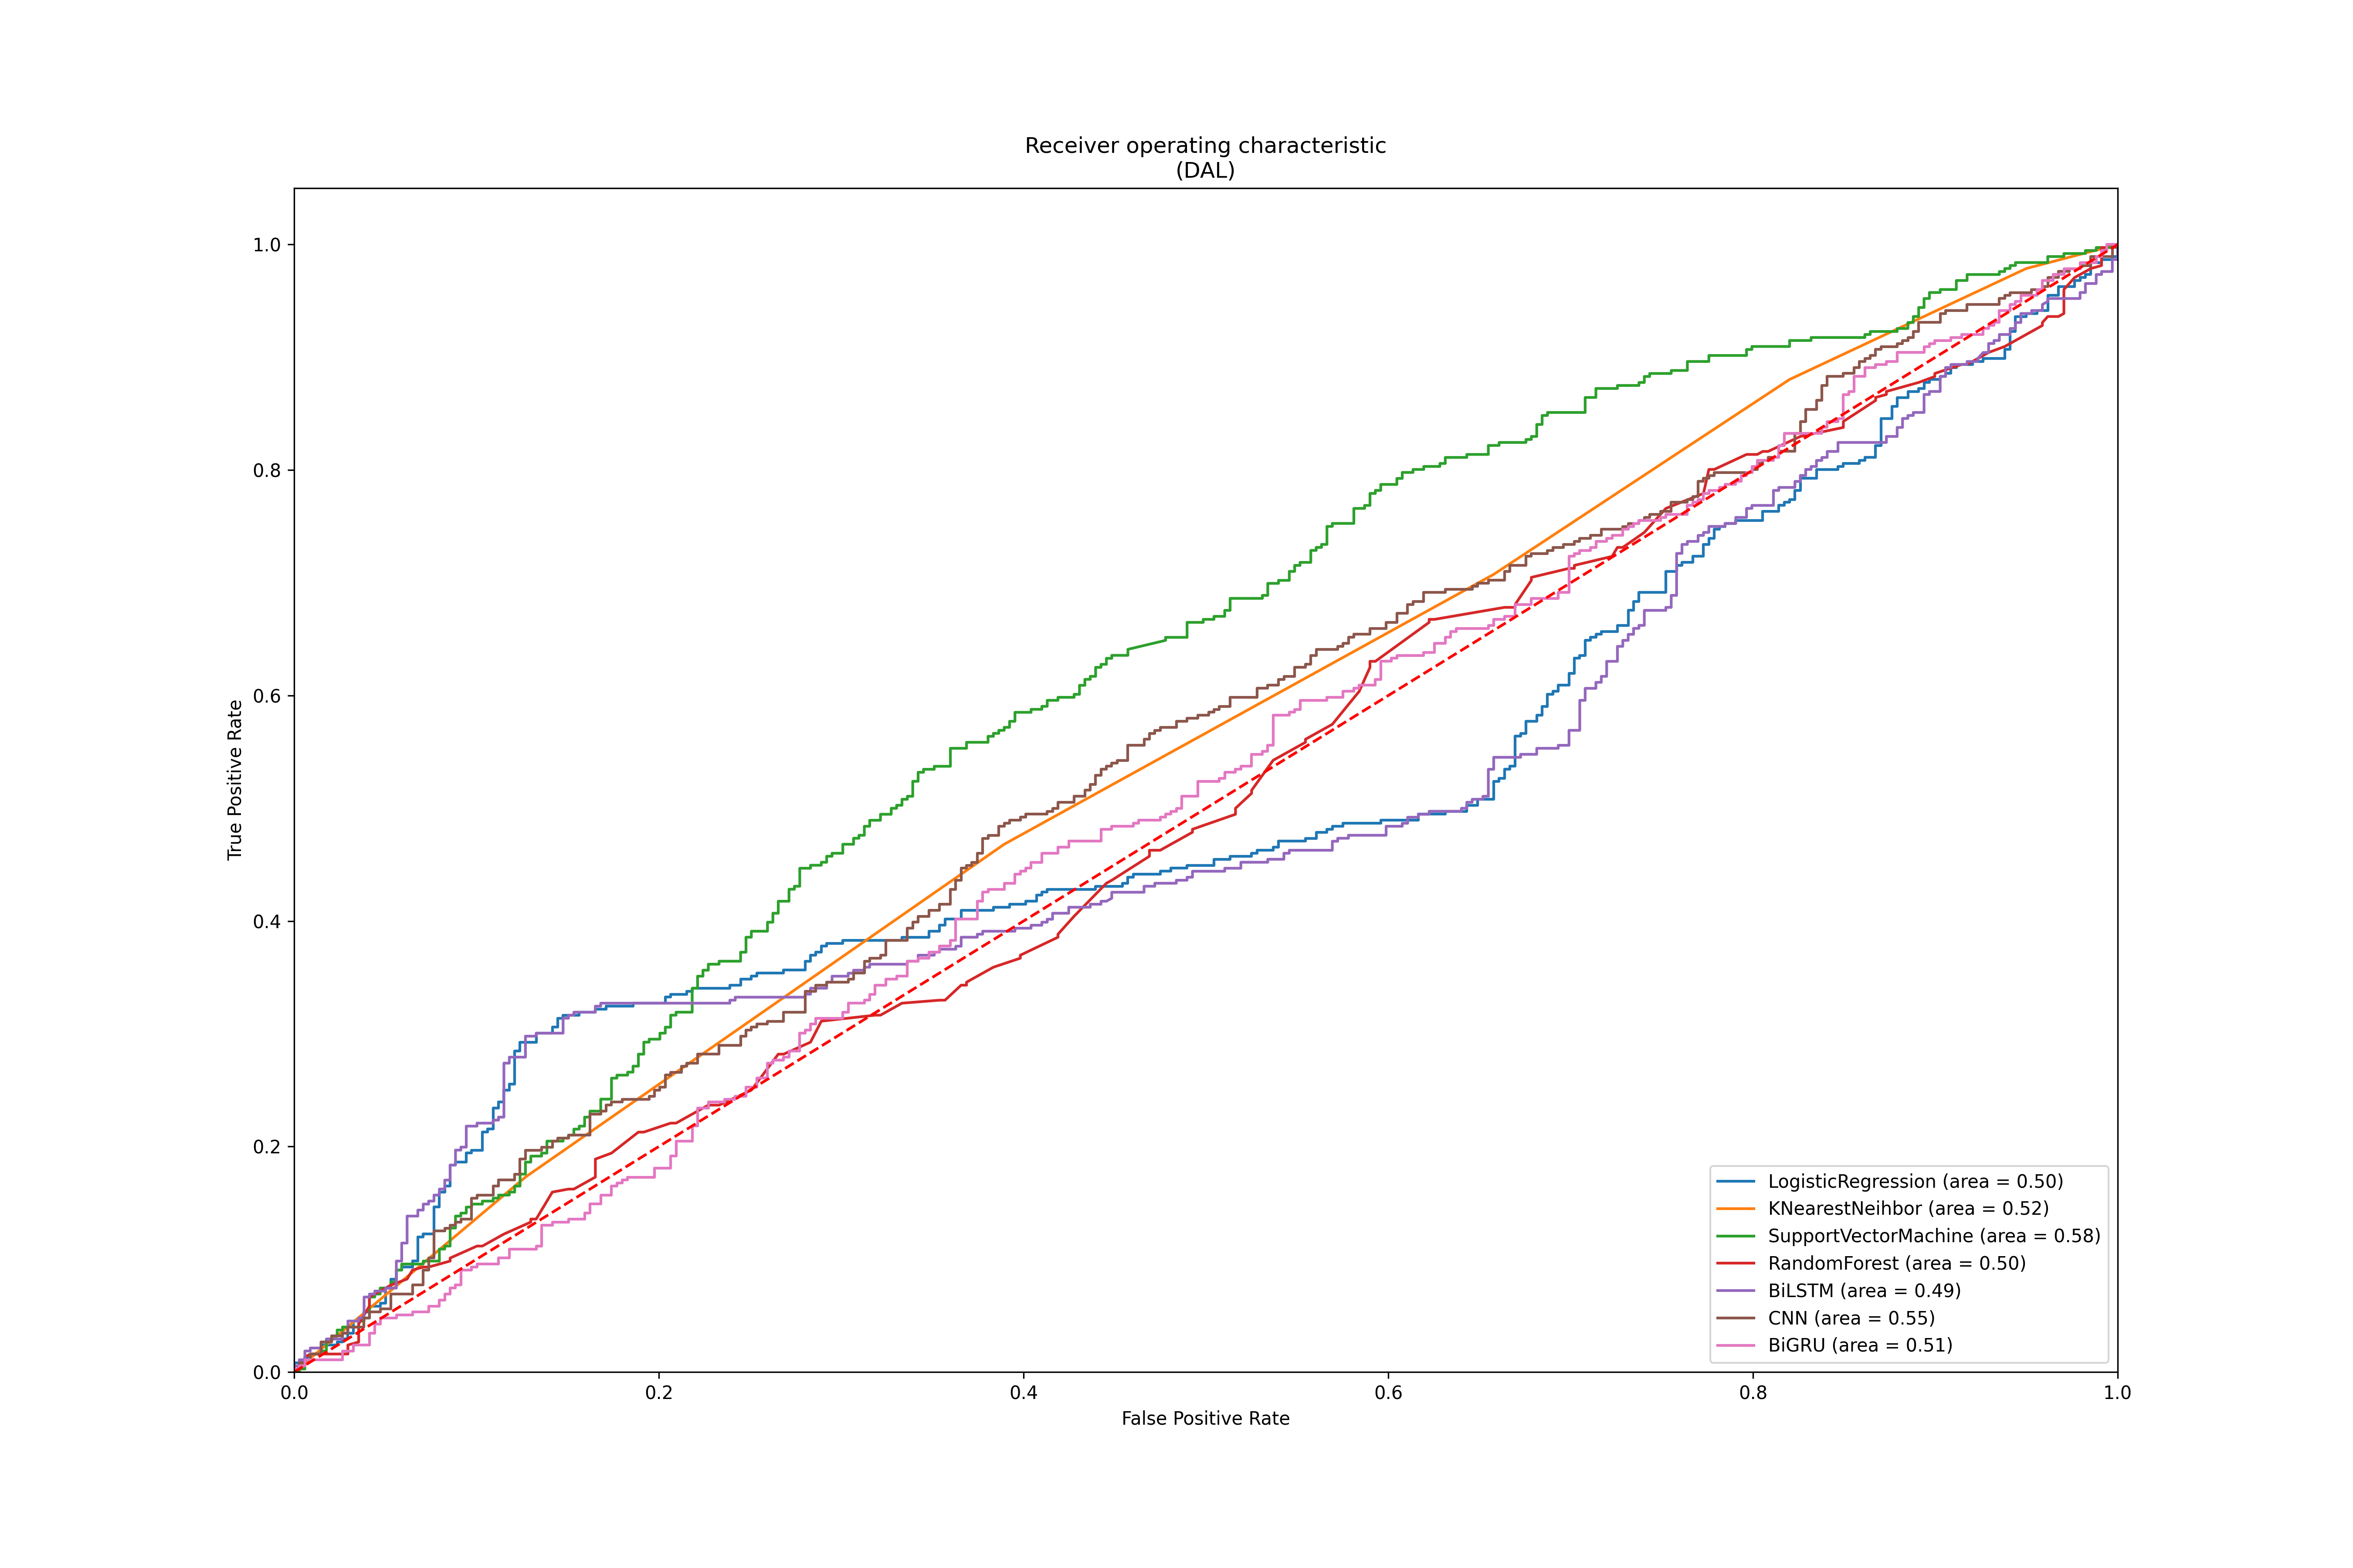
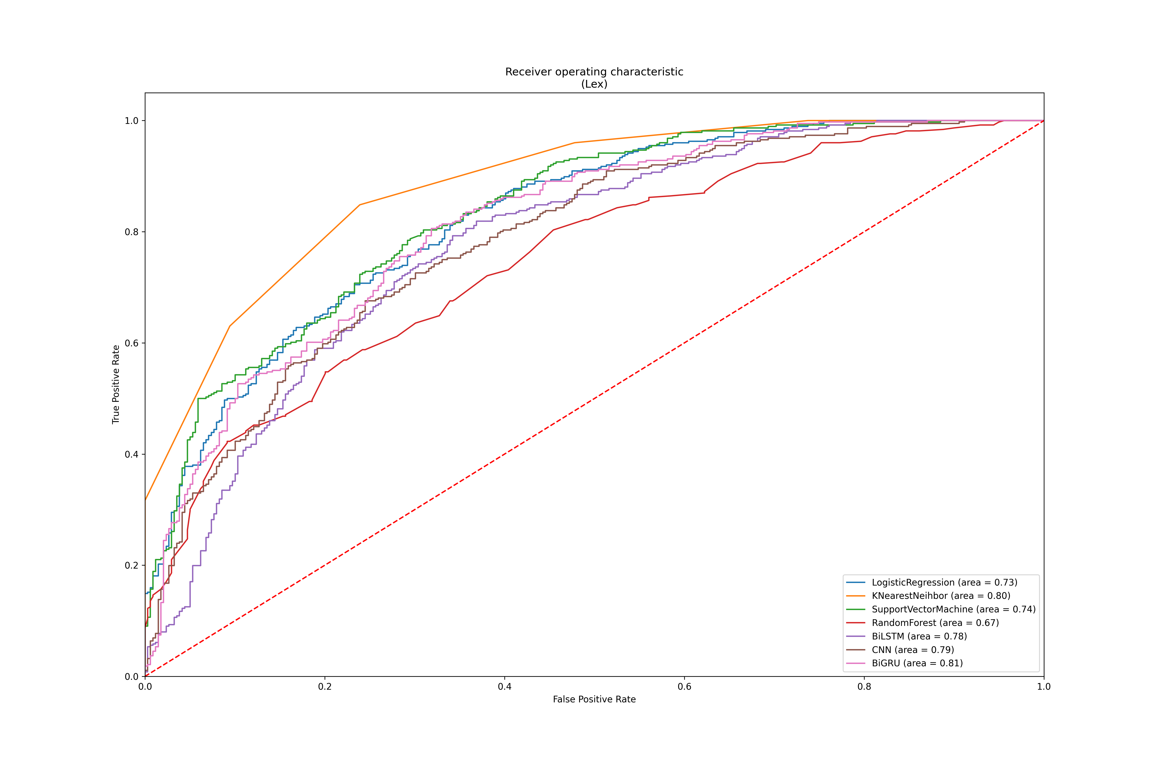
Evaluation – ROC Curves I
Word2Vec

Slide 17
Conclusions
“Stressed” class Recall score ( high importance in medical tasks )
KNN outperformed the other models ( BiGRU the NNs )
Emotion features improve classifier sensitivity
Stress detection
lexical problem
resources developed with psychological applications in mind (e.g. LIWC, DAL, etc. )
NNs tend to overfit quickly due to lack of data compared to non NNs

Slide 18
Future work
Enrich the dataset with more samples
Additional experiments:
Mental Health contribution
Model types
Model fine-tuning (grid search – time consuming, fine-tune on several feature combinations)
Features
Text embeddings (e.g. GloVe)
Subreddit categories / threads
Further data scaling

Slide 19

Thank you

